Slide 1

Department of Computer Science and Engineering Academic Year (2023-24) 22CSE48 - Mini Project using Java CAR RACING GAME
Guided By
Ms.- SANDHYA NILESH BARGE
Designation - Assistant Professor
Dept. of CSE, NHCE
Name – ROHIT RAJ
USN - 1NH22CS268
Name – PRASHANT BIMAL JHA
USN – 1NH22CS269

Slide 2

Contents
Objectives
Abstract
Requirement Specification
Design
Methodology
Implementation Roadmap

Slide 3
Objectives
Basic Game Structure: Define the game's structure, including the main menu, gameplay screen, and possibly a game-over screen.
Car Movement: Implement car movement using keyboard inputs or other controls. This involves handling acceleration, braking, and steering.
Obstacles and Tracks: Create a track with boundaries and obstacles, ensuring the car interacts with them appropriately (e.g., collision detection).
Game Logic and Rules: Establish game rules, such as lap completion, scoring, or time trials. Implement logic to determine when the game ends and how the winner is decided.
Graphics and User Interface: Design a user-friendly interface, incorporating graphics for the cars, tracks, and any other visual elements.

Slide 4

Abstract
The "Car Racing Game" is a thrilling Java-based application offering an immersive gaming experience. It has its own login page and database of players. Players engage in high-speed races, maneuvering virtual cars through challenging tracks. A key highlight is its user-centric design, requiring player sign-in to access personalized profiles and game progress storage. The game emphasizes realistic car physics. Visually captivating graphics adorn dynamic tracks filled with obstacles. A unique rule sets this game apart—colliding with other cars results in an immediate game over, urging players to reach maximum speed while avoiding collisions to achieve higher scores.

Slide 5
Requirement Specification
Software:-
Eclipse IDE
JDK with swing components
Frameworks & Applets
Firebase / MYSQL Database connectivity
Hardware:-
8 Gb RAM
256 Gb ROM
Windows or any other OS
Internet

Slide 6
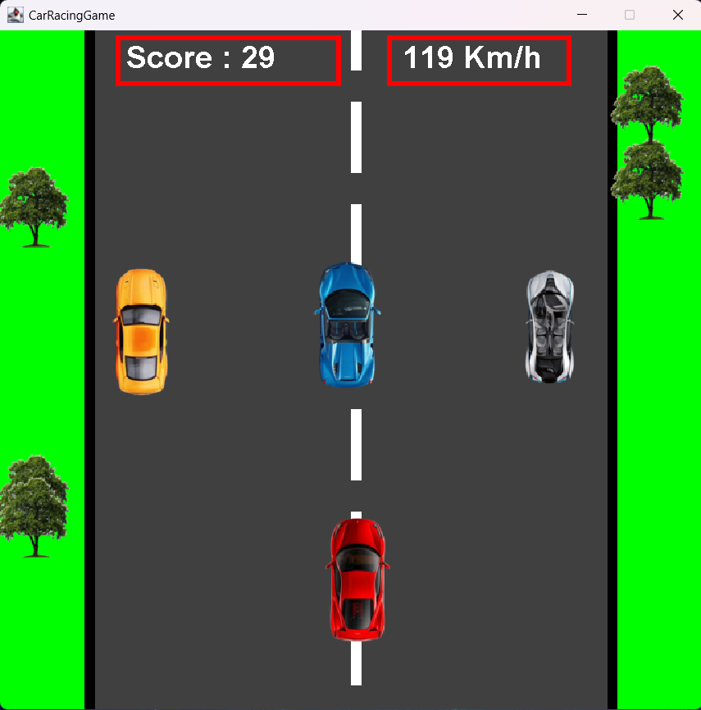
Design

Slide 7
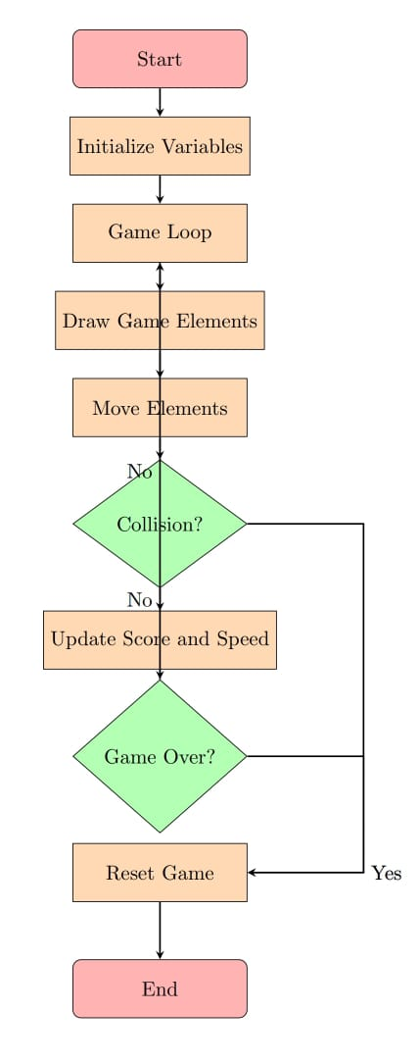
Flow Chart

Slide 8
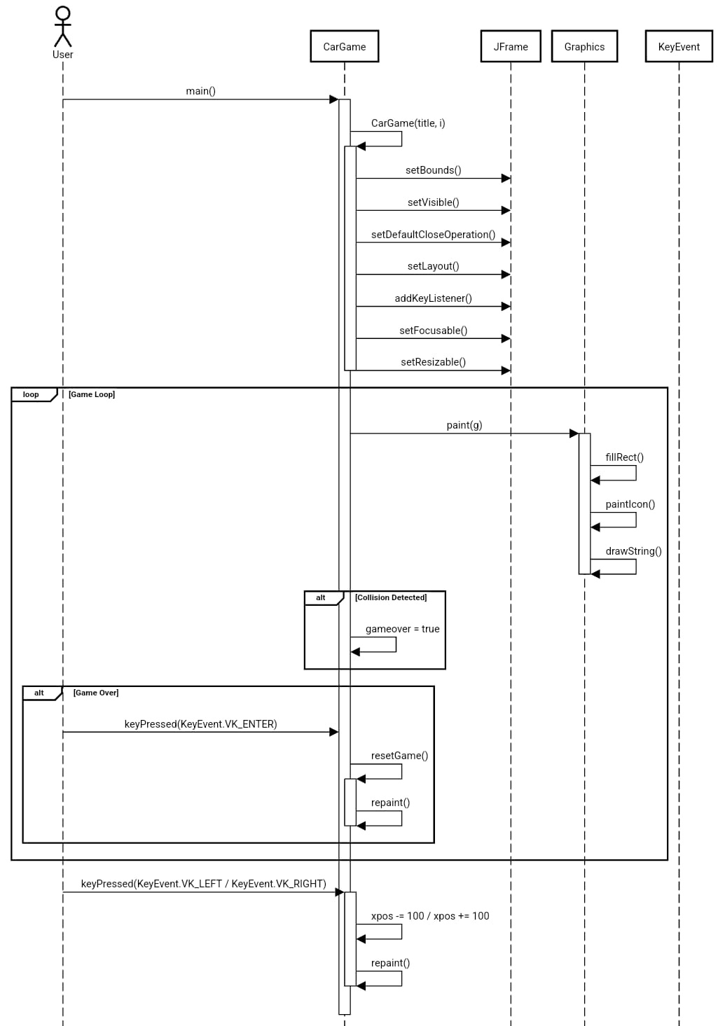
UML SEQUENCE DESIGN

Slide 9
Implementation Roadmap
Setup and Environment Preparation:
Install necessary development tools (IDE, Java SDK, libraries like JavaFX).
Create a new project structure in your IDE for the game.
User Authentication Module:
Implement user sign-in/sign-up functionality.
Set up a basic database or file system to store user data securely.
Car Movement and Controls:
Develop car movement mechanics (acceleration, steering, braking).
Map keyboard inputs or controls to car movements.
Game Logic and Collision Handling:
Define game rules, including collision detection with track boundaries and other cars.
Implement game-over conditions upon collisions.
Graphics and UI Development:
Create visual assets for cars, tracks, menus, and user interfaces.
Implement UI elements for main menus, gameplay screens, and scoring displays.
Integration and Testing:
Integrate all developed modules and functionalities into the game.
Conduct thorough testing for each aspect (user authentication, car movement, collisions, UI, sound) to ensure functionality and identify bugs.

Slide 10


